Slide 1

Individual Service Strategy (ISS) – WIOA Youth (Part II)
WIOA TITLE I TRAINING VIDEO SERIES – march 2021
Notes:
Welcome back to the WIOA Title I Training Video Series.

Slide 2
WIOA Title I Training Series
Clarifying Expectations and Key Takeaways
Individual Employment Plan
Measurable Skill Gains
Work Experience
Exit
Individual Service Strategies
Credential Attainment
Follow-up Services (Youth)
Notes:
This training video continues our focus on the ISS and offers specific information about how the ISS can be documented in AOSOS.

Slide 3
ISS: A Roadmap for and of Youth Experience
An ISS provides the standards for assessment, development, and implementation of Individual Service Strategies for youth under the Workforce Innovation and Opportunity Act (WIOA) Youth Program.
Needs and Assets Assessment
Service Strategy Development
Service Strategy Implementation
Achievement of Outcomes
Notes:
Again, an ISS is meant to offer a roadmap for and of youth experience. Planning and activities related to the ISS should be documented in AOSOS.

Slide 4
Plan Components
Plan Development and Use
ISS Core Elements
Assessment of Need
Identification of Career Pathway
Connection to WIOA Performance Indicators
Planned and Actual WIOA Services
Referrals for Partner Services
Additional Requirements
ISS must reflect the unique needs of each participant
ISS must be signed by the youth worker and the participant
ISS must be reviewed at least every six months with the youth’s participation
ISS must be updated every time there is a significant event
Youth must actively participate in the development of the plan in their ISS
The ISS must be shared with all program providers.
Notes:
An ISS’s plan components, as well as its development and use should be part of an AOSOS record.

Slide 5
Plan Components
ISS Core Elements
Assessment of Need
Identification of Career Pathway
Connection to WIOA Performance Indicators
Planned and Actual WIOA Services
Referrals for Partner Services
Notes:
The first plan component is the assessment of need.

Slide 6
Assessment of Need
Academic Assessment
Must include a review of the youth’s basic skills.
Academic levels can be reviewed through previous assessments
For Out-of-school youth:
Must be assessed for basic skills utilizing a standardized assessment tool
Must crosswalk to educational functioning levels.
Occupational Skill Assessment
Assessment of skills includes review of:
Occupational skills
Prior work experience
Employability and interests and aptitudes.
Skill levels may be assessed utilizing:
Aptitude tests
Career/interest inventories.
Supportive Service Needs Assessment
Assessment of youth must include a review of the youth’s:
Supportive service needs
Developmental needs
Supportive services include:
Transportation
Child care
Dependent care
Needs-based payments
Other needs serving as a barrier to participation
Notes:
This includes academic assessment, occupational skill assessment, and supportive service needs assessments should all be documented in AOSOS.

Slide 7
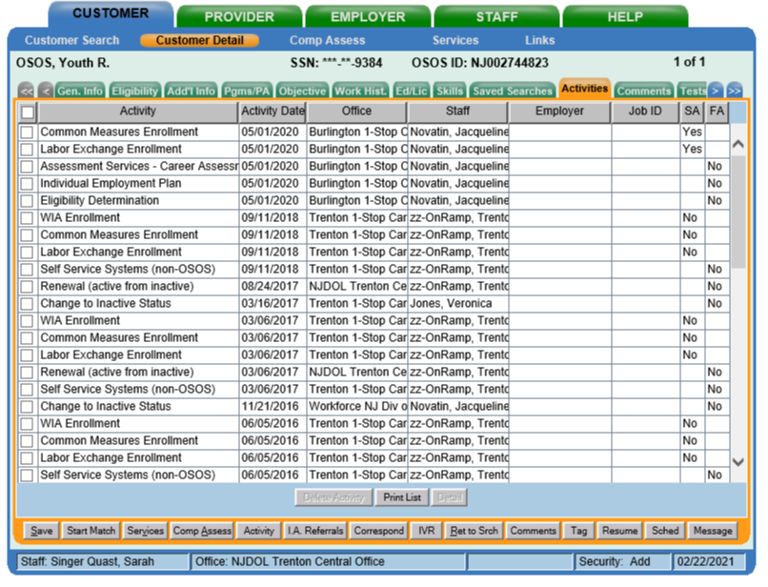
AOSOS Roadmap
Assessment of Need → Customer Detail and Comp Assess
Step 1: All assessment activities should be captured in the Activities tab in Customer Detail
Notes:
First, specific Assessment activities must be entered in the Activities tab in customer detail.

Slide 8
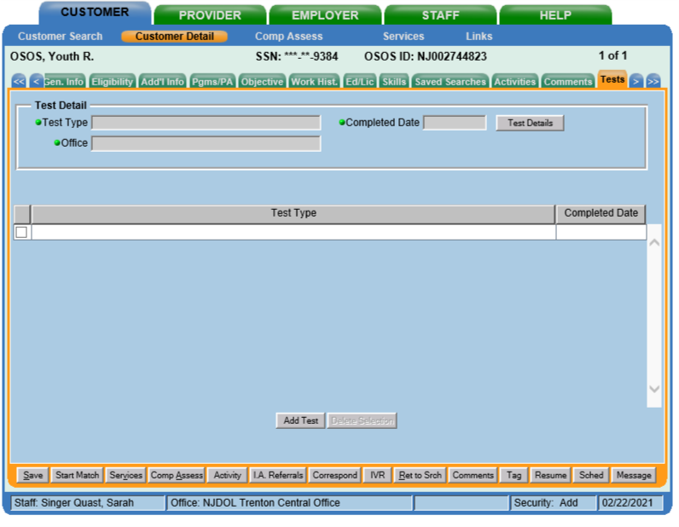
AOSOS Roadmap
Assessment of Need → Customer Detail and Comp Assess
Step 2: Academic test results should be captured in Test tab in Customer Details
Notes:
Additionally, academic assessment results, specifically CASAS test results can be captured in the Test tab in Customer Detail

Slide 9
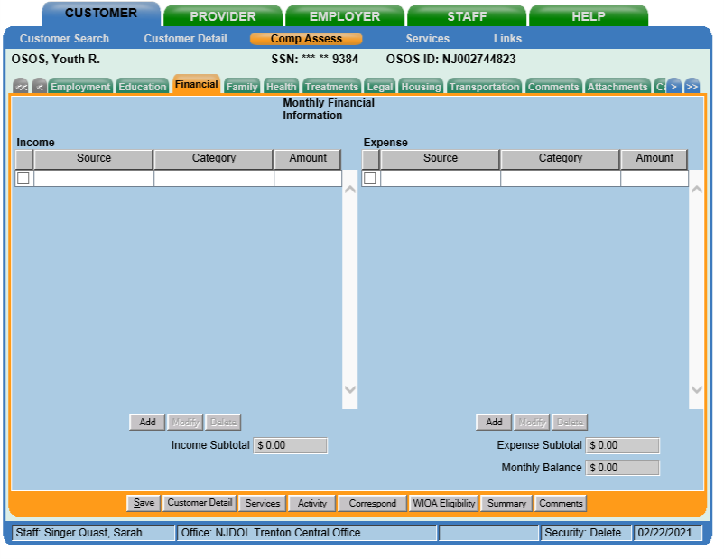
AOSOS Roadmap
Assessment of Need → Customer Detail and Comp Assess
Step 3: Occupational and service need assessment results should be captured across the tabs in Comp Assess
Notes:
Occupational and service need assessment results should be captured across the tabs in Comp Assess

Slide 10
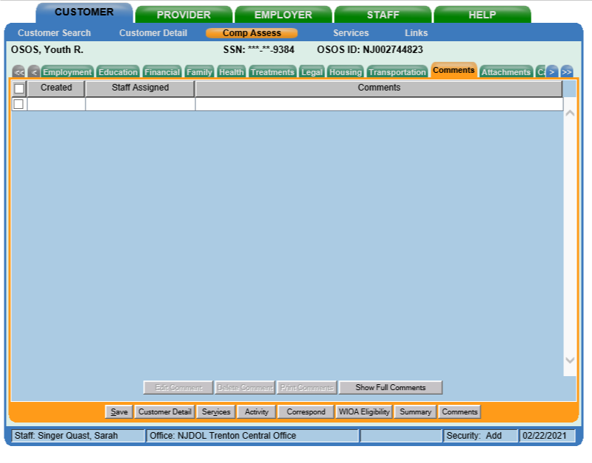
AOSOS Roadmap
Assessment of Need → Customer Detail and Comp Assess
Step 4: Additional documentation of these assessments and their results should be captured in the Comments tab in Comp Assess
Notes:
Additional documentation of these assessments and their results that are not captured in the tabs themselves should be captured as comments in Comp Assess

Slide 11
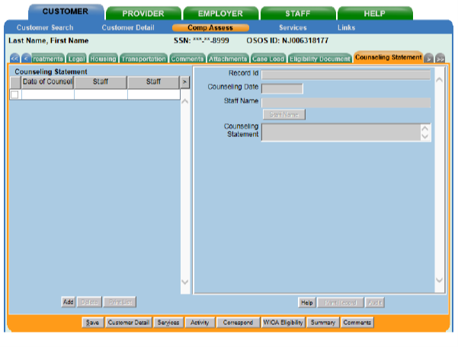
AOSOS Roadmap
Assessment of Need → Customer Detail and Comp Assess
Step 4: Additional documentation of these assessments and their results should be captured in the Comments tab in Comp Assess
Note: Confidential information should be captured in Counseling Statements.
Notes:
However, it is important to note that confidential information should not be highlighted in comments tab but rather as a counseling statement in comp assess, to protect this confidential information. This screen is only available to individuals in specific counseling roles.

Slide 12
Plan Components
ISS Core Elements
Assessment of Need
Identification of Career Pathway
Connection to WIOA Performance Indicators
Planned and Actual WIOA Services
Referrals for Partner Services
Notes:
Details around career pathways and connection to specific performance indicators should also be captured in AOSOS records.

Slide 13
Identification of Career Pathway
Career Pathway: The term ‘‘career pathway’’ means a combination of rigorous and high-quality education, training, and other services. A career pathway should include specific education and/or employment goals, and reflect the following:
In-Demand Occupation Alignment
Alignment with the skill needs of industries in the economy of the State or regional economy involved
Preparation for Pathway Success
Preparation to be successful in any of a full range of secondary or postsecondary education options
Counseling Support
Inclusion of counseling to support an individual in achieving the individual’s education and career goals
Integration of Education and Workforce Preparation
Inclusion of education offered concurrently with and in the same context as workforce preparation activities and training
Coordinated, Individualized Support
Organization of education, training, and other services to meet the particular needs of an individual in a manner that accelerates the educational and career advancement
Achievement of Education Outcomes
Opportunities for an individual to attain a secondary school diploma or equivalent, and at least 1 recognized postsecondary credential
Pathway Entrance/ Advancement
Opportunities for an individual to enter or advance within a specific occupation or occupational cluster
Notes:
Including various details about career pathways

Slide 14
Connection to WIOA Performance Indicators
Measurable Skills Gain: Documented academic, technical, occupational, or other forms of progress, towards a recognized credential or employment
Education Placement: Participation and retention in education or training activities
Credential Attainment: Obtainment of a recognized postsecondary credential or a secondary school diploma, or its equivalent
Employment Placement
Participation and retention in unsubsidized employment
Notes:
And specifics about the alignment of an individual’s specific goals with WIOA’s indicators of performance

Slide 15
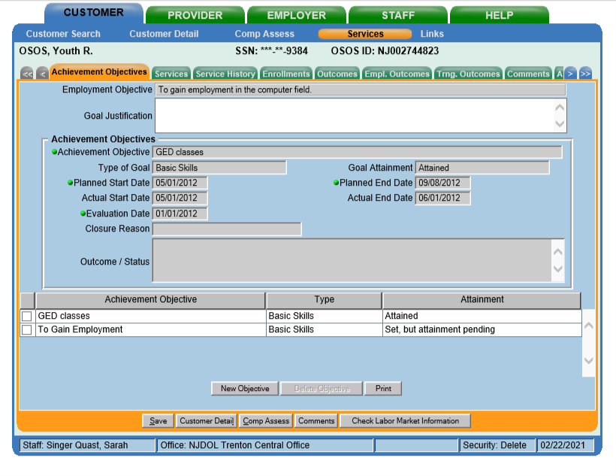
AOSOS Roadmap
Career Pathways and Performance Indicators → Services and Comp Assess
Step 1: Document specific details related to goals, career pathways, and indicators of performance in:
Achievement Objectives tab in Services
Employment and Education tabs in Comp Assess
Notes:
Specifics related to career pathways and goals can be documented in the Achievement Objectives tab in Services

Slide 16
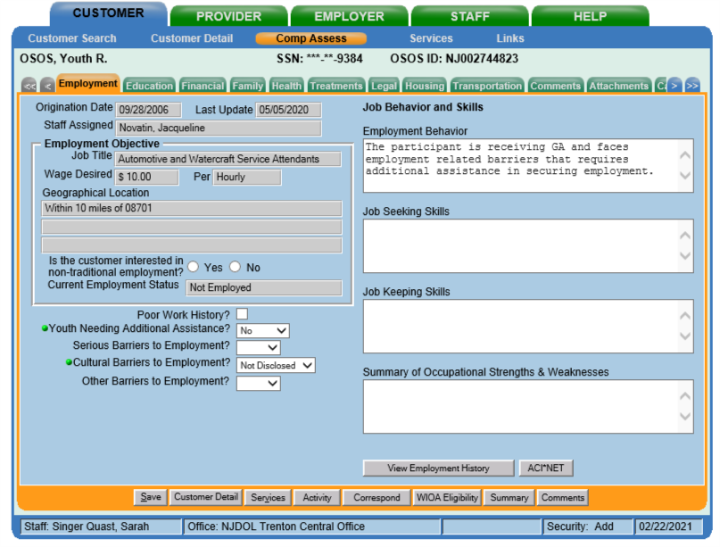
AOSOS Roadmap
Career Pathways and Performance Indicators → Services and Comp Assess
Step 1: Document specific details related to goals, career pathways, and indicators of performance in:
Achievement Objectives tab in Services
Employment and Education tabs in Comp Assess
Notes:
as well as in the Employment and Education tabs in Comp Assess.

Slide 17
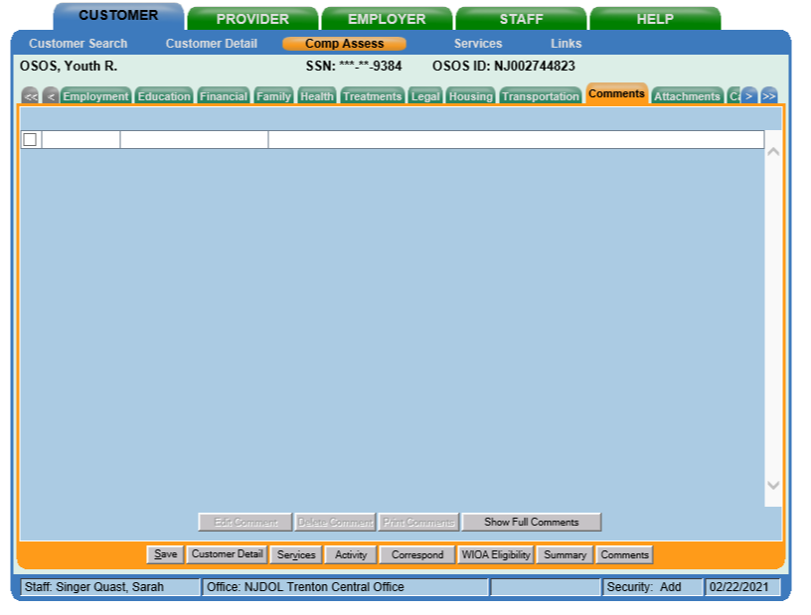
AOSOS Roadmap
Career Pathways and Performance Indicators → Services and Comp Assess
Step 2: Document any additional details in the Comments tab in Comp Assess.
Notes:
Any additional details not reflected in these tabs should be included in the comments tab in Comp Assess.

Slide 18
Plan Components
ISS Core Elements
Assessment of Need
Identification of Career Pathway
Connection to WIOA Performance Indicators
Planned and Actual WIOA Services
Referrals for Partner Services
Notes:
In addition, WIOA services that align with assessment results and identified career pathways and goals should be documented

Slide 19
Planned and Actual WIOA Services
Alt Secondary School
Assessment results should inform program elements that will assist youth in achieving goals
All program elements should be available to each youth
Each youth must be provided the program elements that are determined appropriate for them
Each youth is expected to receive multiple program elements while enrolled in the WIOA youth program.
In addition, follow-up services should be offered and provided for at least 12 months following exit
Work Experience
Occupational Skill Training
Tutoring
Education/ Workforce Prep
Leadership Develop- ment
Supportive Services
14 Program Elements
Guidance and Counseling
Adult Mentoring
Follow-up Services
Financial Literacy
Entre- preneurial Skills
Labor Market Information
Post- Secondary Prep
Notes:
An AOSOS record should include services tied to various program elements, as well as offer additional details that provide evidence of an intentional and integrated service strategy.

Slide 20
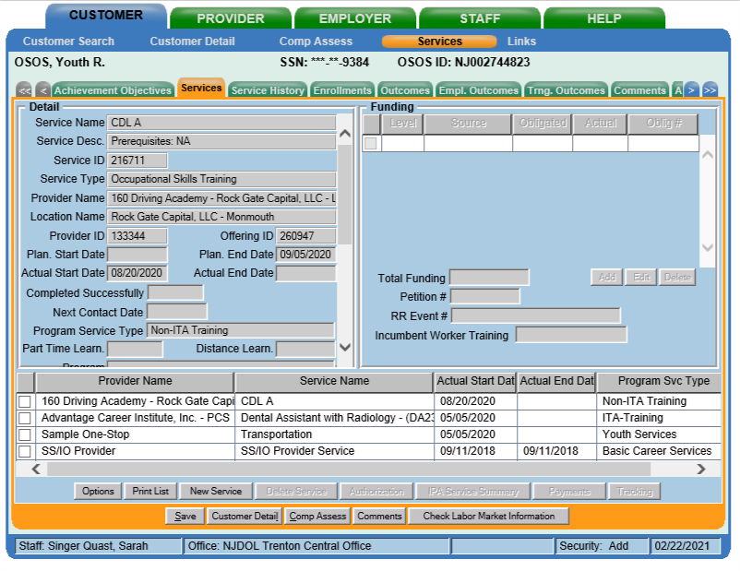
AOSOS Roadmap
Planned and Actual WIOA Services→ Services
Step 1: Designate and fund specific services that align with the Program Elements that a participant is receiving in the Services tab in Services.
Notes:
Specifically, program elements should be designated and funded as services in the services tab.

Slide 21
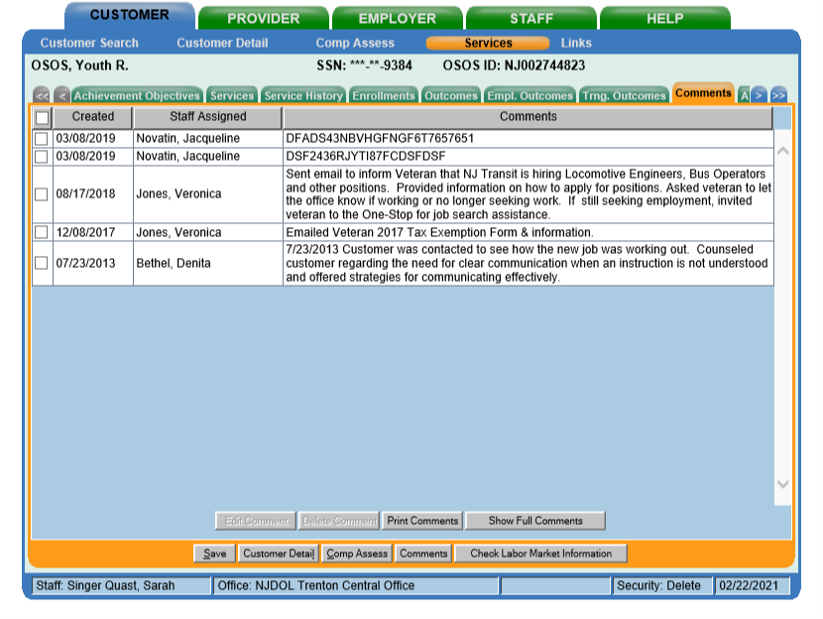

AOSOS Roadmap
Planned and Actual WIOA Services→ Services
Step 2: Document specific details related to specific program element services and experience in services in the Comments tab in Services.
Notes:
Additional notes and details should be highlighted in the Comments tab in Services. Ultimately, an AOSOS record should offer a clear story about a young person’s engagement in WIOA youth services.

Slide 22
Plan Components
ISS Core Elements
Assessment of Need
Identification of Career Pathway
Connection to WIOA Performance Indicators
Planned and Actual WIOA Services
Referrals for Partner Services
Notes:
Finally, any referrals to partner services should also be documented in AOSOS

Slide 23
Referrals for Partner Services
The Department does not require local programs to use WIOA youth funds for each of the program elements.
Local programs may leverage partner resources to provide some of the readily available program elements.
The local area must ensure that if a program element is not funded with WIOA Title I youth funds, the local program has an agreement (MOU) in place with a partner organization to ensure that the program element will be offered.
The Local Board must ensure that the program element is closely connected and coordinated with the WIOA youth program.
Notes:
The inclusion and integration of how partner services connect to broader strategies should be clear.

Slide 24
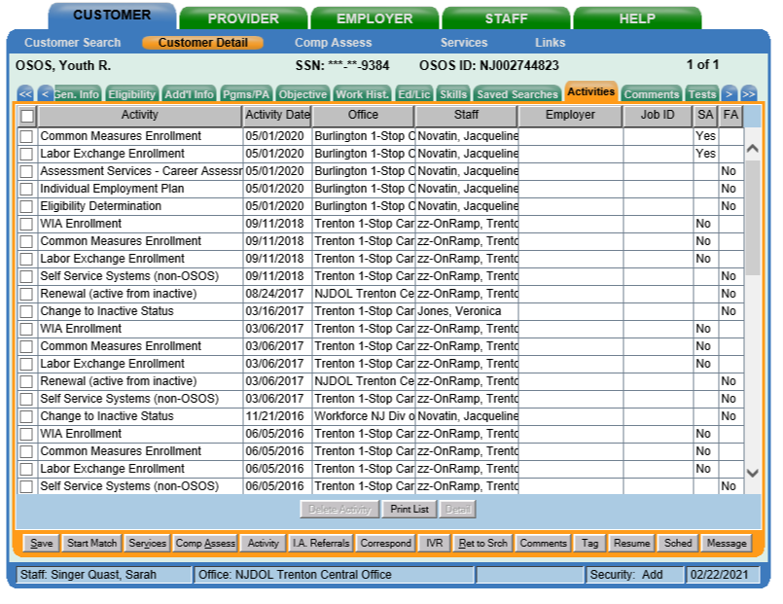
AOSOS Roadmap
Referrals to Partner Services: Comp Assess and Services
Step 1: Any referrals to partner services should be captured in the Activities tab in Customer Detail.
Notes:
Referrals to partners should be designated and captured as Activities (since they are not funded services) in Customer Detail.

Slide 25
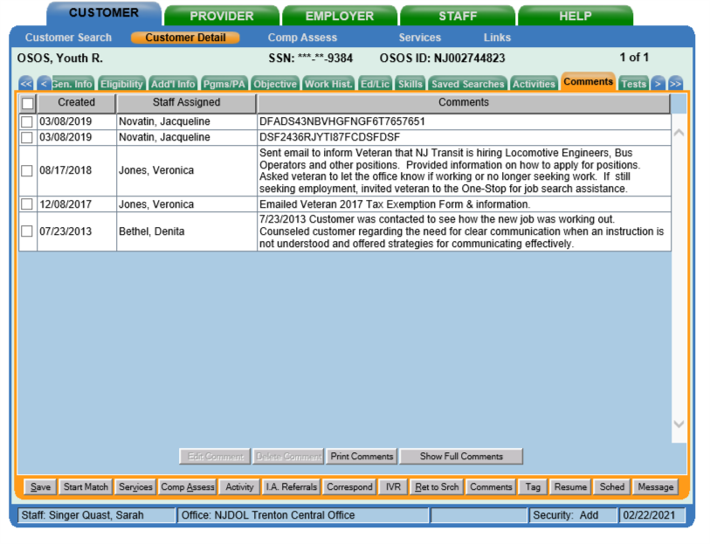
AOSOS Roadmap
Referrals to Partner Services: Comp Assess and Services
Step 2: Documentation and details about this referral services should be captured in Comments in Customer Detail.
Notes:
Additional information and details about referral services should also be captured in Comments in Customer Detail.

Slide 26
Plan Components
Plan Development and Use
ISS Core Elements
Assessment of Need
Identification of Career Pathway
Connection to WIOA Performance Indicators
Planned and Actual WIOA Services
Referrals for Partner Services
Additional Requirements
ISS must reflect the unique needs of each participant
ISS must be signed by the youth worker and the participant
ISS must be reviewed at least every six months with the youth’s participation
ISS must be updated every time there is a significant event
Youth must actively participate in the development of the plan in their ISS
The ISS must be shared with all program providers.
Notes:
In addition to program components, specifics around development and use should also be highlighted in AOSOS.

Slide 27
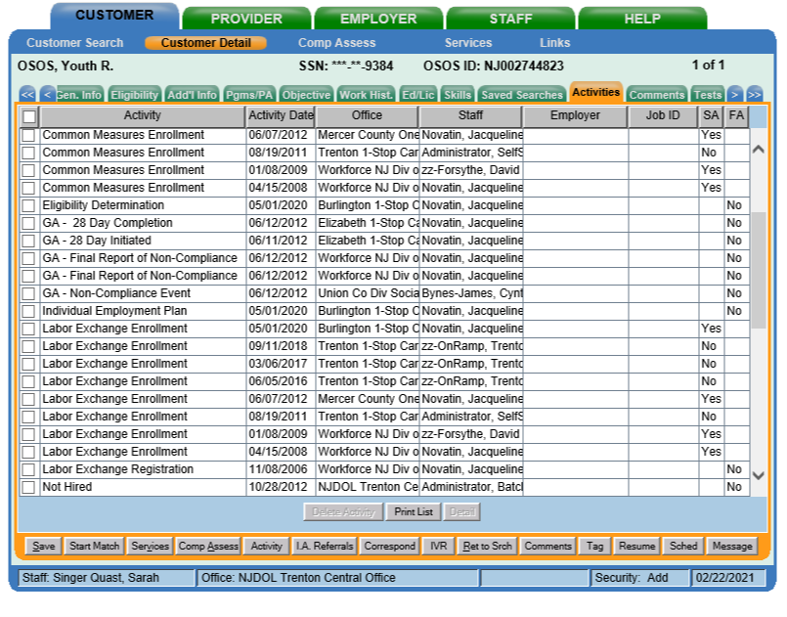
AOSOS Roadmap
Plan Development and Use
Step 1: An IEP activity should be designated every time there is engagement around the ISS in the Activities tab in Customer Detail.
Notes:
Every time there is engagement around the ISS – at the point of creation and when plans are revisited and updated, an IEP activity should be designated in Customer Detail.

Slide 28
AOSOS Roadmap
Plan Development and Use
Step 2: Details about ISS points of engagement should be documented in Comments in Services.
Notes:
Additionally, details and notes about these points of engagement should be documented in Comments in Services.

Slide 29
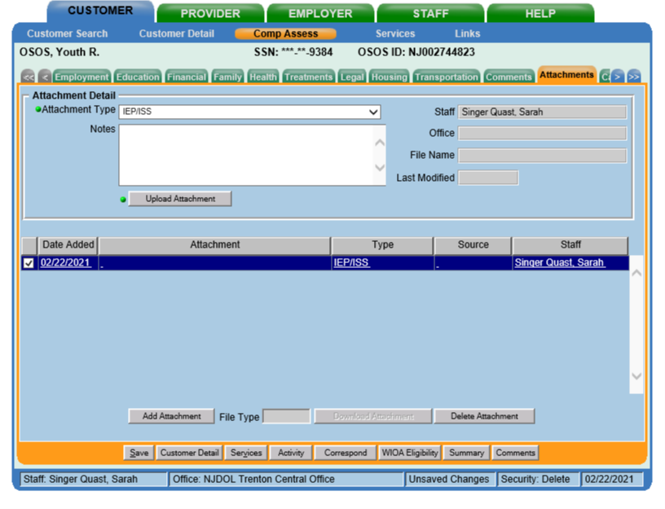
AOSOS Roadmap
Plan Development and Use
Step 3: The paper ISS should be uploaded each time it is updated as an Attachment in the Attachments tab in Comp Assess.
Notes:
Finally, when a new ISS version is complete this should be uploaded in the Attachments tab in Comp Assess.

Slide 30
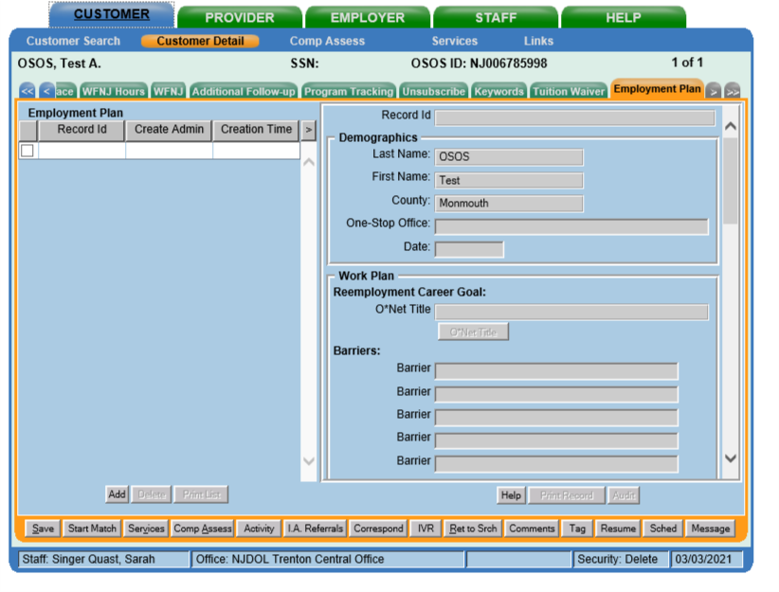
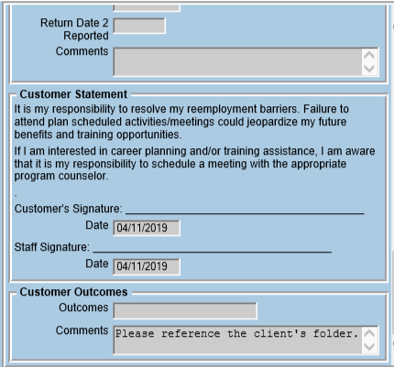
AOSOS Roadmap
Plan Development and Use
Step 4: Elements of the ISS may also be recorded and documented in the Employment Plan tab in Customer Detail
Notes:
Additionally, for reporting purposes, an entry and note should be made in the Employment Plan tab in Customer Detail. At minimum, this tab should include an employment plan entry and date and a comment in the comment field at the bottom of the employment plan that highlights that the ISS is in the attachments or client’s folder.

Slide 31
Additional Resources
NJDOL Policy
NJ Workforce Innovation notices including WD-PY19-7 that outlines specific ISS policy can be found here:
https://www.nj.gov/labor/wioa/resources/
AOSOS Training Videos
Specific tutorials about entering Activities and Comments, the tabs in Customer Detail, and the tabs in Comp Assess can be found here: https://towork.dol.state.nj.us/aosostrainingmaterials/_layouts/15/start.aspx#/
Contact us at Career Services with any questions at WIOApolicy@dol.nj.gov
Notes:
This concludes our training videos about the ISS. Additional resources including NJDOL’s policies and a series of training tutorials on AOSOS may help to augment knowledge of concepts highlighted in this training. If you don’t have access to these materials or have any additional questions, don’t hesitate to reach out to us at WIOApolicy@dol.nj.gov

